Slide 1
Group 6 – MIE 1624 Introduction to Data Science and Analytics
Final Term Project

Slide 2
Outline
Job Market Glance
Data Collection
Course Curriculum Redesign
Evaluation of Existing Programs
Master’s Degree Program Design
Master of Data Science and Analytics
Master of Business and Management in Analytics and AI
Data Science EdTech Proposal

Slide 3
Job Market Glance
A look into the market trends of Data Scientist and Data Analyst Jobs

Slide 4
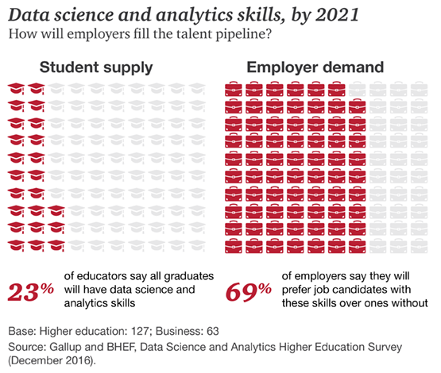
Job Market Glance
Demand and Supply
Top Jobs by Job Growth Rate (2012-2017)
Source: LinkedIn

Slide 5
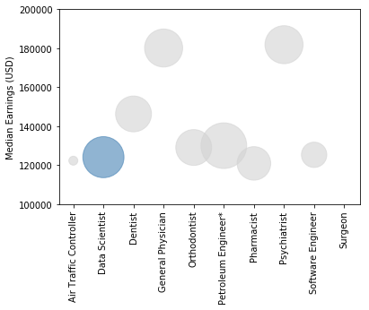
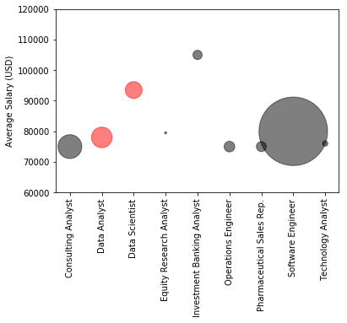
Job Market Glance
Top Jobs by Mid-Career Earnings
Top Entry Level Jobs by Earnings
Source: CNBC
Source: US News

Slide 6
Data Collection
Use of Kaggle and Indeed Datasets

Slide 7
Skill Trends in Recent Job Postings

Slide 8
What’s Important in Data Science?
Source: Kaggle

Slide 9
Data Inferences
Soft skills are extremely vital
Demand for data science skills is increasing rapidly
Supply of students with required skills will not meet growing demand
Most programs are not fully compliant with current work demands
Programming languages, visualization tools, querying languages form the backbone of technical toolkits
Top skills require strong knowledge in machine learning

Slide 10
Course Curriculum Redesign
Modifying the current course – Introduction to Data Science and Analytics to cater to current demands.

Slide 11
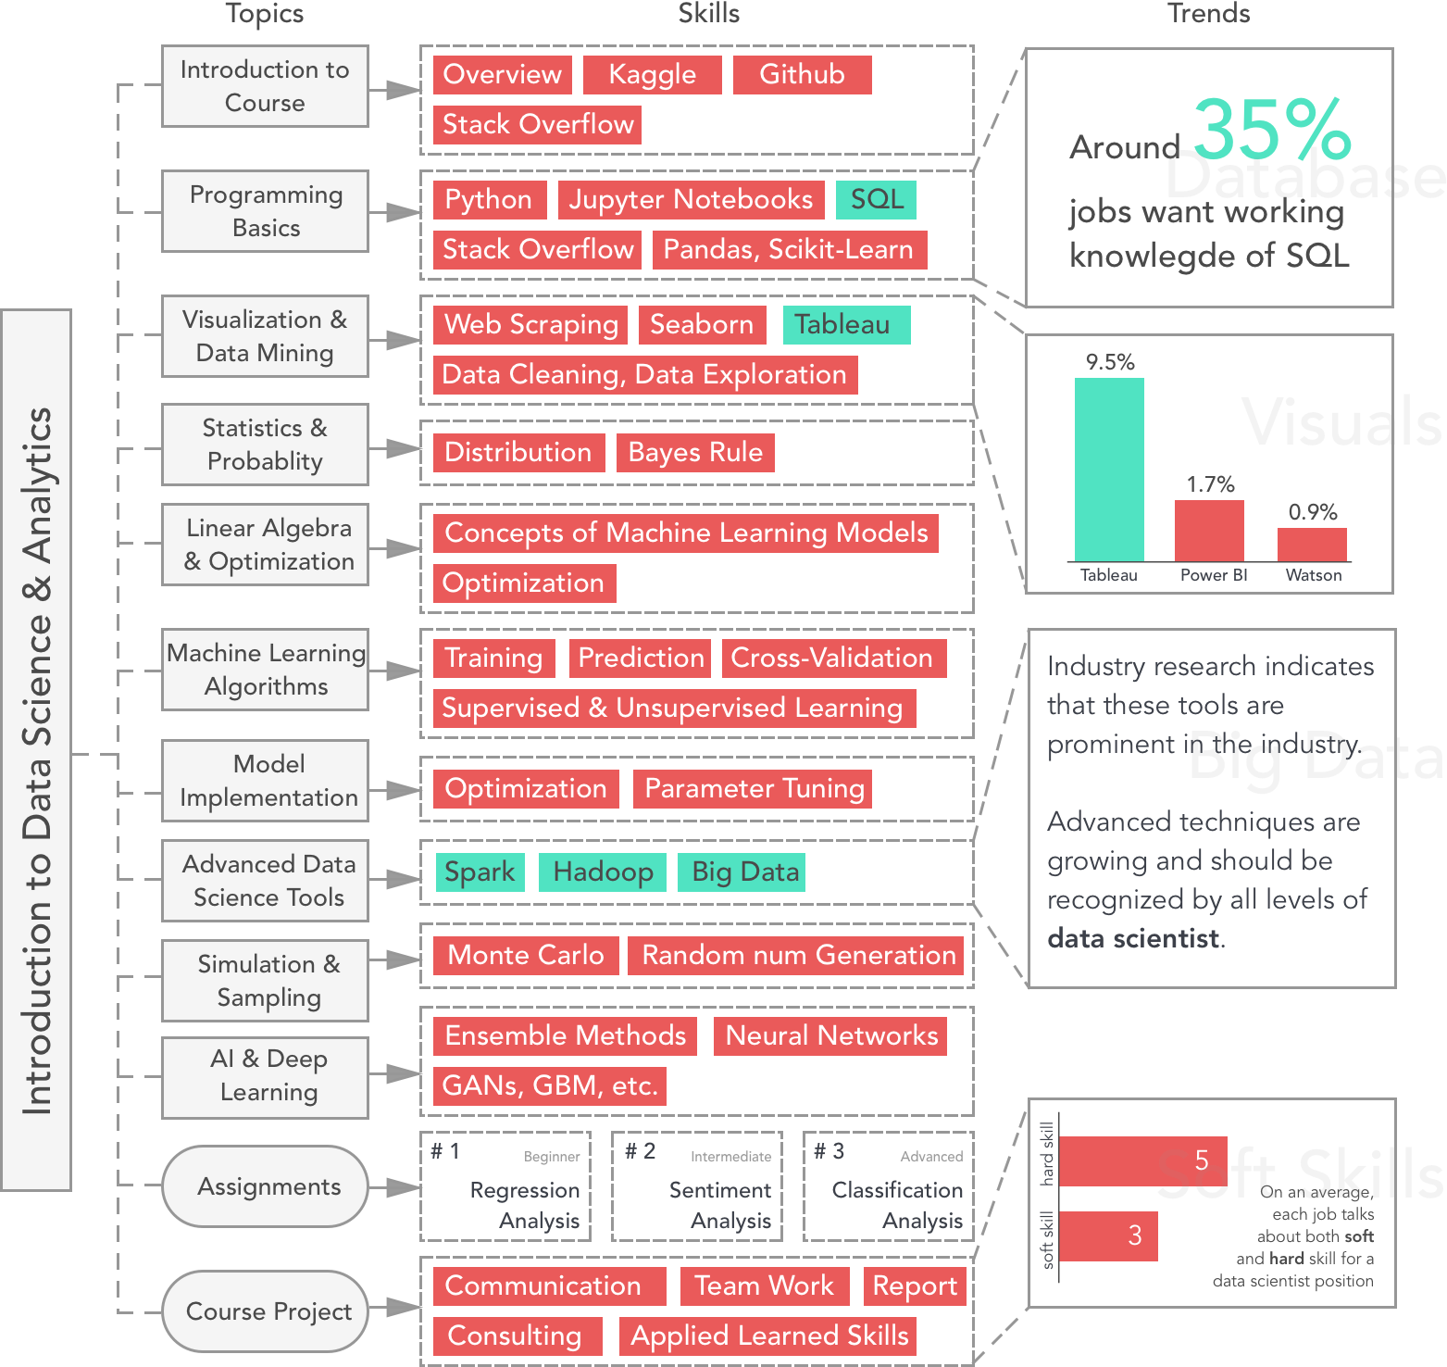

Slide 12
Evaluation of Current Programs

Slide 13
Program Evaluation Criteria
Fundamental Courses
25%
Essential Courses
65%
Extra Courses
10%

Slide 14
Current Master’s Program Evaluations

Slide 15
Master of Science – Data Analytics (MSDA)

Slide 16
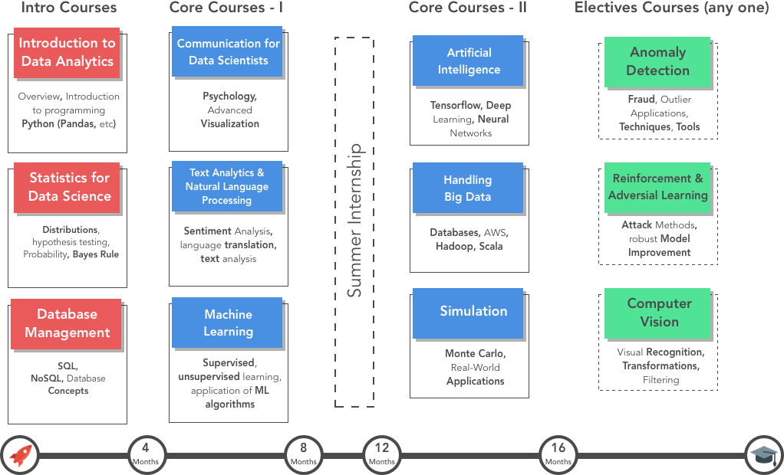
Program Design - MSDA

Slide 17
Master of Business And Management in Analytics and AI (MBAI)

Slide 18
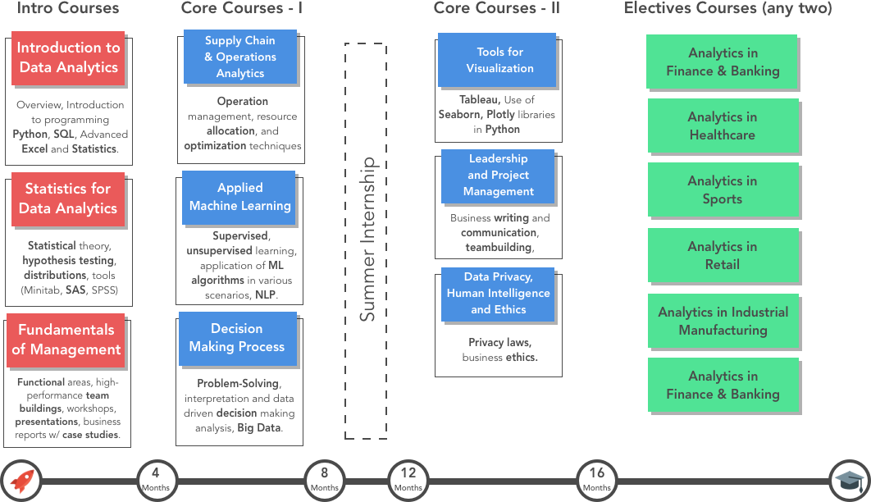
Program Design - MBAI

Slide 19
EdTech: D’eXpert
Be a Data Scientist in 4 weeks

Slide 20


Slide 21
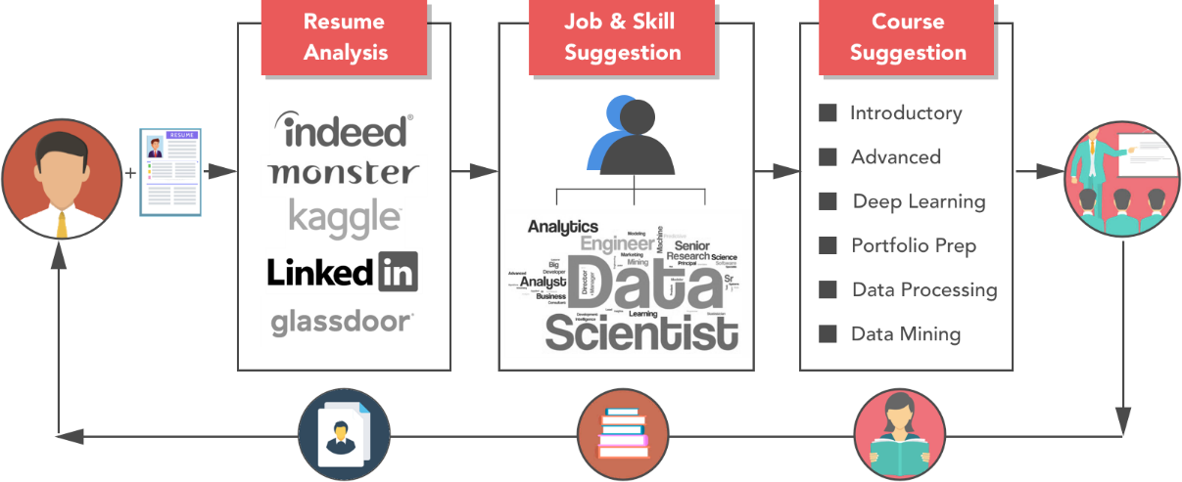
D’eXpert – Be a data scientist in 30 days
Prepare and further develop careers of data scientists
Job skills & Course suggestions based on resume analysis system
Curated courses with special topics for real-world data analytics problems

Slide 22
QUESTIONS?
Thank You

